Slide 1


Slide 2


FAKE NEWS CLASSIFICATION
Final Year Project Synopsis
Submitted by
ROLL | NAME
2201062040 | AAYUSH UJJWAL
Industry Mentor: Jasleen Kaur Bhatia
Faculty Mentor: Jyoti Kataria
Notes:
New Courses replaced with New Programmes

Slide 3


Project Overview
This project helps to find a way to utilize Natural Language processing (NLP) to identify and classify fake news articles. The main objective is to detect the fake news, which is a classic text classification problem.
We gathered our data, pre-processed the text, and converted our articles into features for use in supervised models.
It is needed to build a model that can differentiate between “Real” news and “Fake” news.
Notes:
New Courses replaced with New Programmes

Slide 4

Problem Statement
These days, news about current events and particular areas of interest is broadcast on radio and television as well as written in newspapers and on social media worldwide.
Given the rapid expansion of online material, it is getting harder to distinguish between genuine and fake information.
Fake news has consequently spread like wildfire, making it extremely difficult for makers of such information to verify it to prevent public misinformation.
Implement an automated fake news classification model which classify the data into “Fake” or “Real”
Notes:
New Courses replaced with New Programmes

Slide 5
Key Features
Data Collection and preparation, which includes getting the training data, cleaning it and prepare it to the process of features extracting. This step is important to get food results.
Feature Selection, which consists of identifying the features that are most useful for the problem under examination.
Algorithm choice, given the dataset, after selecting the features, we should choose the suitable algorithm to extract these features from the dataset (classification).
Parameter and model selection, which means choosing the machine learning model and setting its parameters to guarantee the best performance with the extracted features.
Build a model, as given the dataset, algorithm, and parameters, training uses computational resources to predict the outputs on new data.
Testing the model, as before the model is used, it needs to be tested and evaluated for accuracy on data that it was not trained on.
Notes:
New Courses replaced with New Programmes

Slide 6
Project Use cases & Scope
The scope of the Fake News Detection System is vast, as it can be applied in various industries where the dissemination of false information can cause significant damage. The system can be used in news agencies, social media platforms, and other online forums to identify and prevent the spread of fake news. With the rise of social media and the ease with which information can be disseminated, it has become increasingly challenging to distinguish between real and fake news. This system can provide an effective solution for this problem and help in maintaining the integrity of information. The market scope of this system is also significant, as there is a growing demand for tools that can help in detecting fake news. Additionally, the system can be used as a plugin in web browsers or social media platforms to provide real-time detection of fake news.
Notes:
New Courses replaced with New Programmes

Slide 7
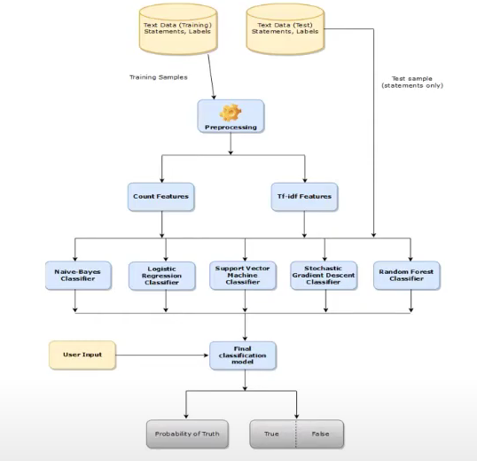
Prototype/Project Flow
diagram/Architecture
Notes:
New Courses replaced with New Programmes

Slide 8
Data & Resources
Software Requirements:
Technology: NLP(Natural Language Processing)
Client Side: HTML, CSS, JavaScript , Bootstrap
Server Side: Anaconda , Python
Operating System: Microsoft Windows
Dataset: The dataset on which we are going to train and test in our project is taken from kaggle i.e. Fake.csv and True.csv.
Hardware Requirements:
4GB RAM
i3 Processor
Notes:
New Courses replaced with New Programmes

Slide 9
Methodology
Natural language processing (NLP) is a machine learning technology that gives computers the ability to interpret, manipulate, and comprehend human language
The NLP software uses pre-processing techniques such as tokenization, stemming, lemmatization, and stop word removal to prepare the data for various applications.
Here's a description of these techniques:
Tokenization breaks a sentence into individual units of words or phrases.
Stemming and lemmatization simplify words into their root form. For example, these processes turn "starting" into "start.“
Stop word removal ensures that words that do not add significant meaning to a sentence, such as "for" and "with," are removed.
Notes:
New Courses replaced with New Programmes

Slide 10

Expected Results & Impact
This project can understand every sentence of the news articles from the dataset using NLP, then classify the news into real and fake news, so we can search for the news sentences in your own English.
It can understand the content and give the result if it is fake or real.
We must update the dataset regularly to get the real-time experience.
It may be look like this -
Notes:
New Courses replaced with New Programmes

Slide 11
THANK YOU

